Slide 1
Working with Template inheritance

Slide 2
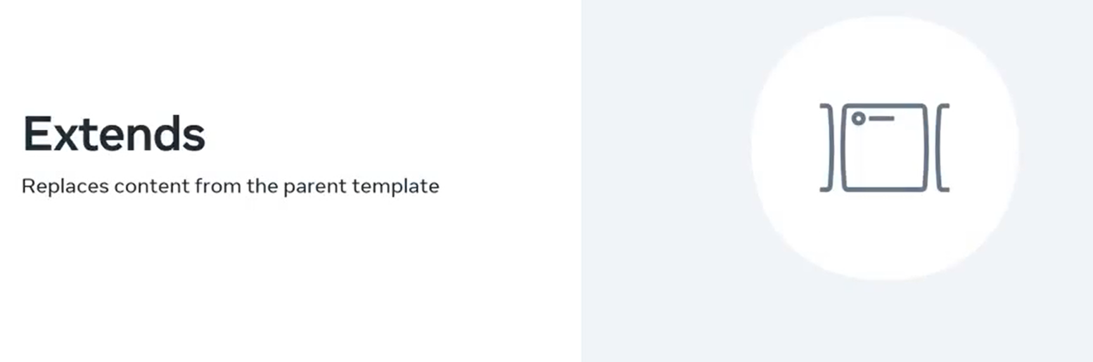

Slide 3
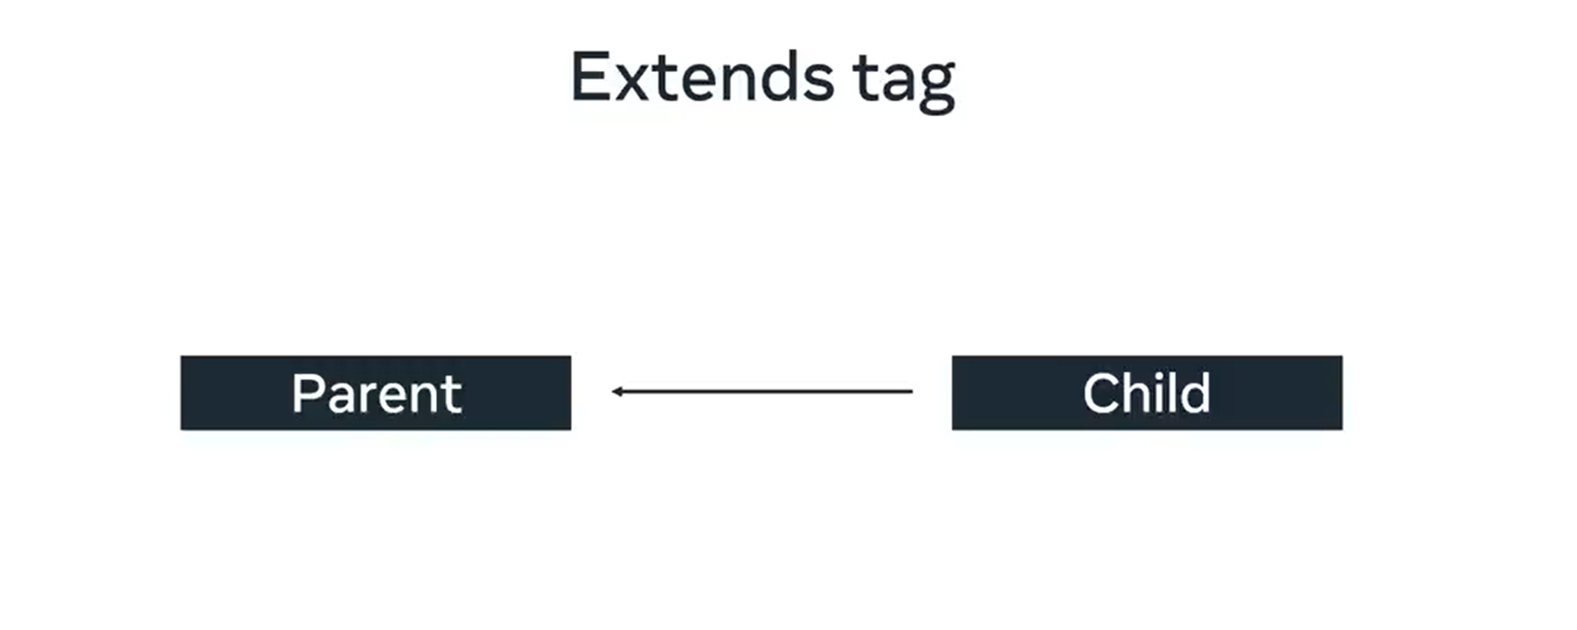

Slide 4


Slide 5


Slide 6
